Slide 1
ICA Proposal : Multimodal Document Layout Components Classifier [DocGCN]
Shashank Sahoo
15th May 2023
KPMG UK
KPMG Framework Slides v1
February 2022

Slide 2
Introduction
01

Slide 3
Introduction
Digital documents (incl. scanned document images and PDF files) are popular and convenient for storing written textual information, as almost 2.5 trillion documents worldwide are available in the digital format.
Recognizing the layout of unstructured digital documents (pdf, png, jpg, tiff etc.) is crucial when parsing the documents into the structured, machine-readable format for downstream application.
Generally, document layout components comprises of Text, Title, List, Table, Figure, Question, Answer, Header, Footer etc.
Current Document Layout Analysis (DLA) algorithms usually rely on visual cues to understand documents while ignoring other information, such as contextual information or the relationships between document layout components, which are vital to boost better layout analysis performance.
The DLA task aims at understanding the documents from either
the physical analysis by detecting the document structure and the boundaries of each layout region or
the logical analysis by categorizing the detected layout components (segments) into the predefined document element classes, such as Title, Date, Author, and Figure.

Slide 4
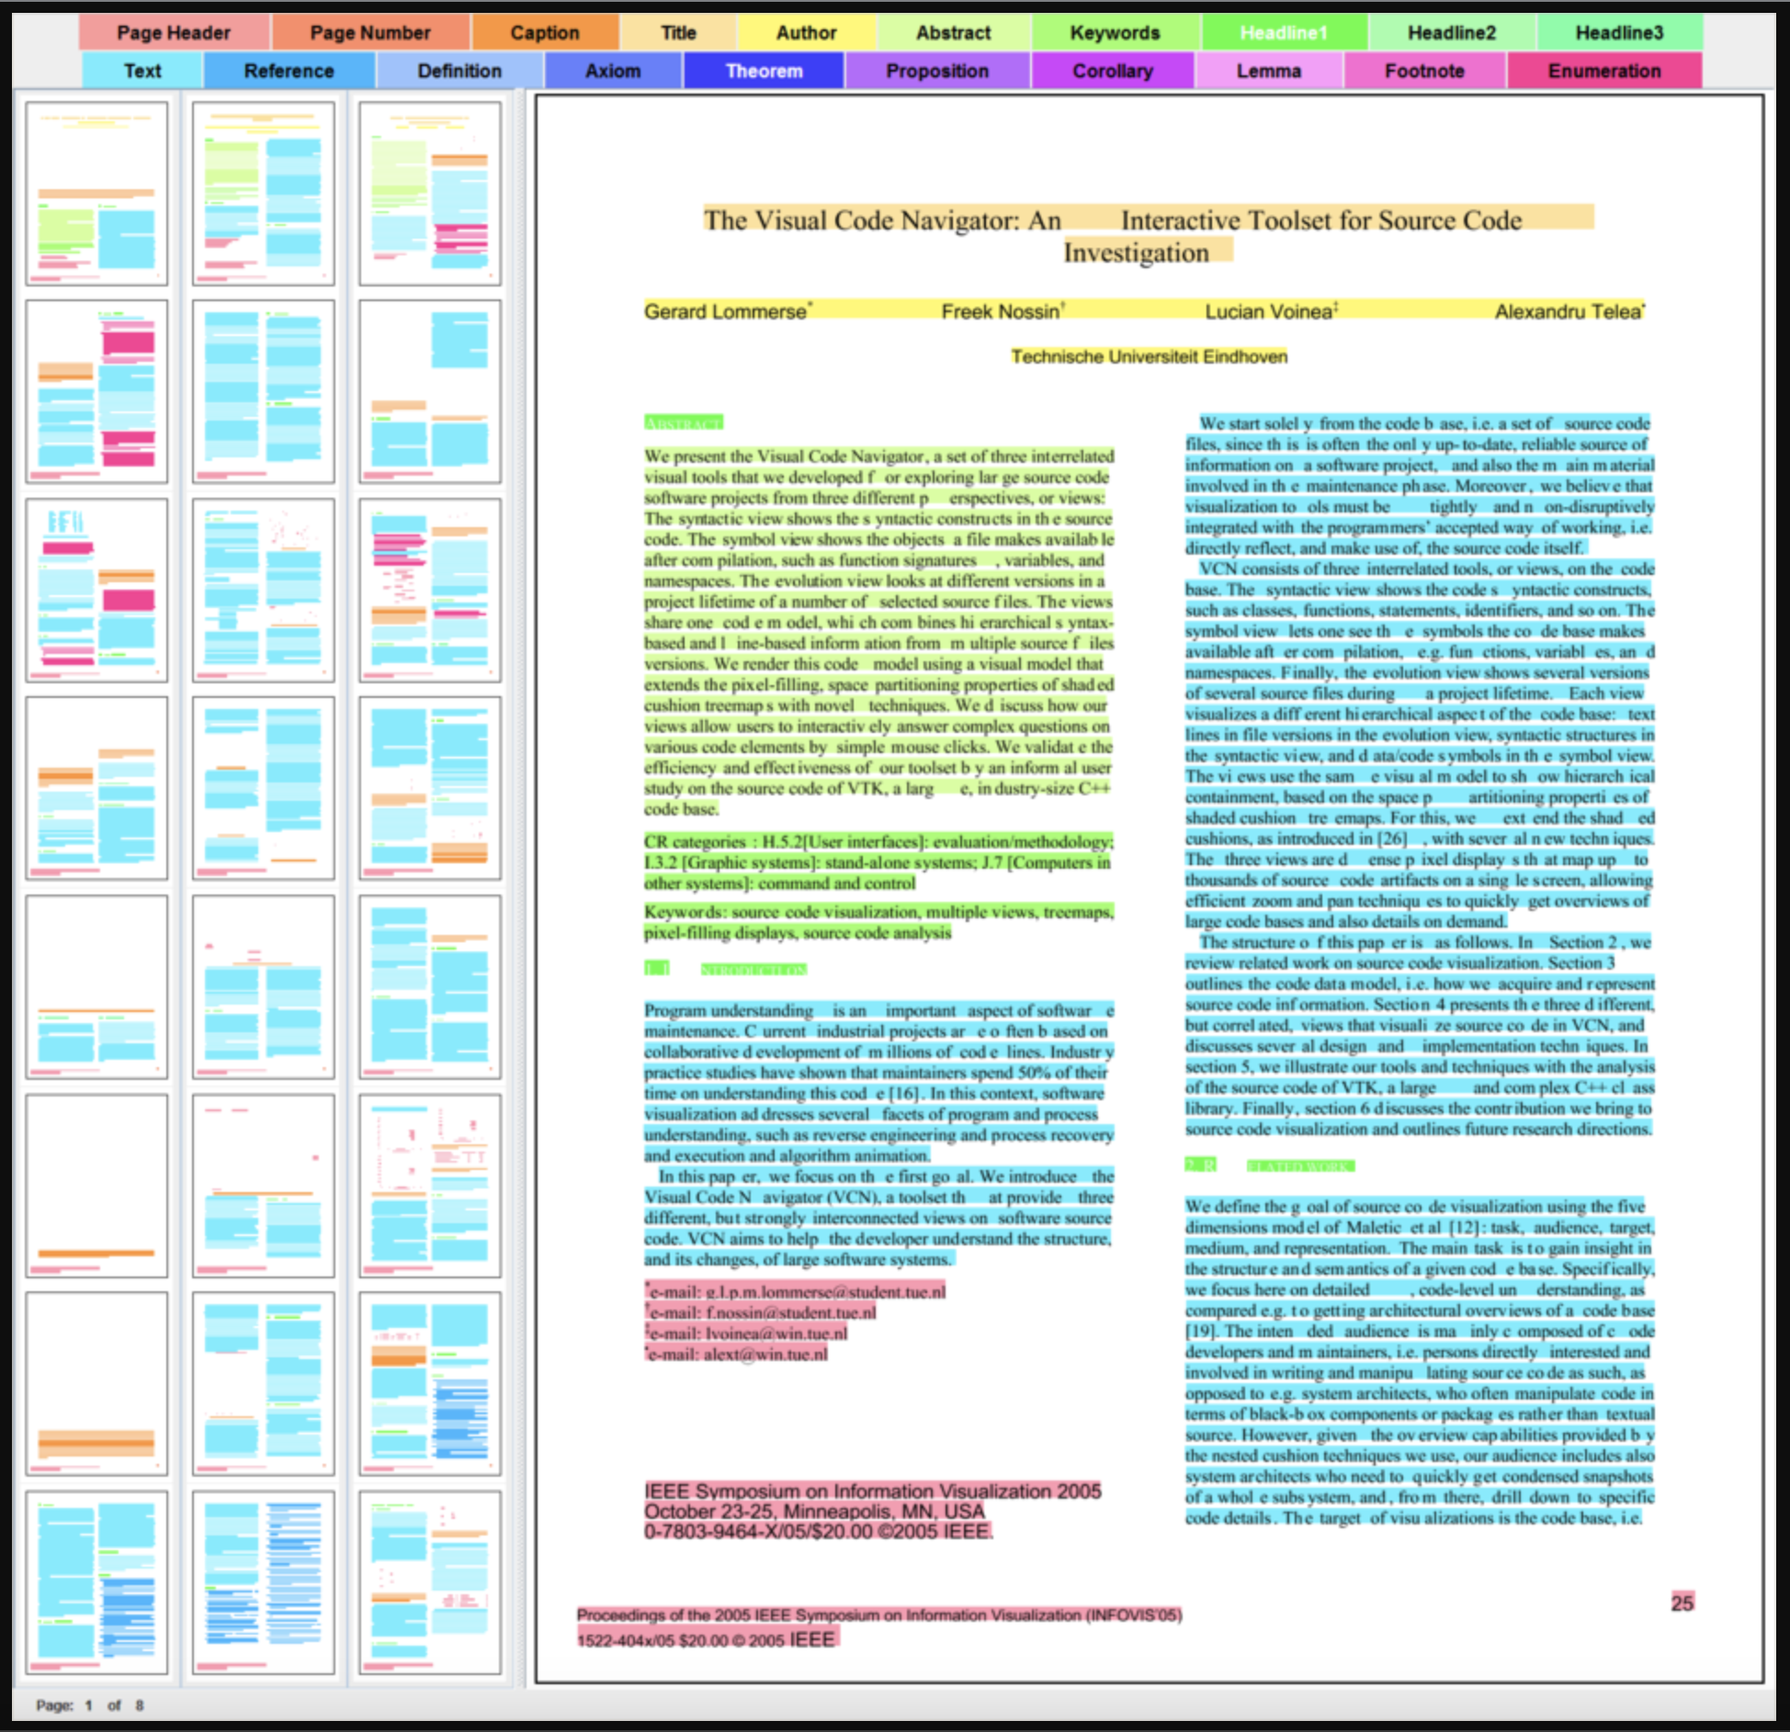
Sample DLA Components
Text
Title
List
Table
Figure
Question
Answer
Header
Footer
Other
Source : AG Keim - Datenanalyse und Visualisierung (uni-konstanz.de)

Slide 5
Proposal Goal
02

Slide 6
Proposal Goal
Goal
The comprehensive aspect of DLA is generally missed with existing approaches as they ignore to comprehend the visual and logical relationship between components and focus purely on key-value pair relationships only.
We have devised a method called DocGCN using Graph Convolutional Networks (GCNs) for DLA which incorporates a holistic perspective to achieve better and enhanced representation of all document features.
DocGCN stands for Heterogenous Graph Convolutional Networks for DLA
We propose DocGCN as an open-source alternative to achieve enhanced feature extraction and representation of document components to perform critical analysis such as identification and classification of components into its constituent elements and provide relation mapping based metadata.
Plan
The idea is to design, build and deploy a heterogeneous/multimodal deep-learning based model to perform document layout analysis using Graph Convolution Networks on unstructured digital documents.
Furthermore, we intend create an inferencing microservice with the support of MSP team to deploy the weights from the trained model for inferencing on any sample digital document.
Currently, it will be scoped as part of ICA offering for Phase II release.
DocGCN microservice could also be leveraged by other solution teams at KIT to perform DLA for their respective downstream tasks.

Slide 7
DocGCN : Solution Components
03

Slide 8
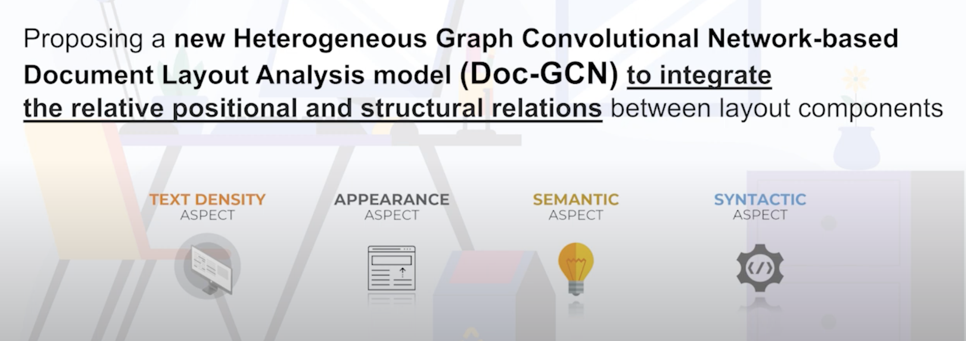
Solution Components
Doc-GCN presents an effective way to harmonize and integrate heterogeneous aspects for Document Layout Analysis. The proposed Doc-GCN contains graphs covering four different aspects of properties of digital document pages, including syntactic, semantic, density, and appearance/visual information . It used graph as a fundamental data structure to represent the document features for Graph based convolutional neural networks
Typically the entire solution can be segregated into the following components as a way forward for implementation:
Density-aspect and Appearance-aspect Graph construction
Characteristics such as text density, total characters, text colour, format, font-size etc is considered.
Syntactic-aspect and Semantic-aspect Graph construction
Characteristics such as parts of speech (Noun, Verb, Adjectives, Adverbs) and self-attention based text embeddings is considered.
Relation Prediction Model to classify components

Slide 9
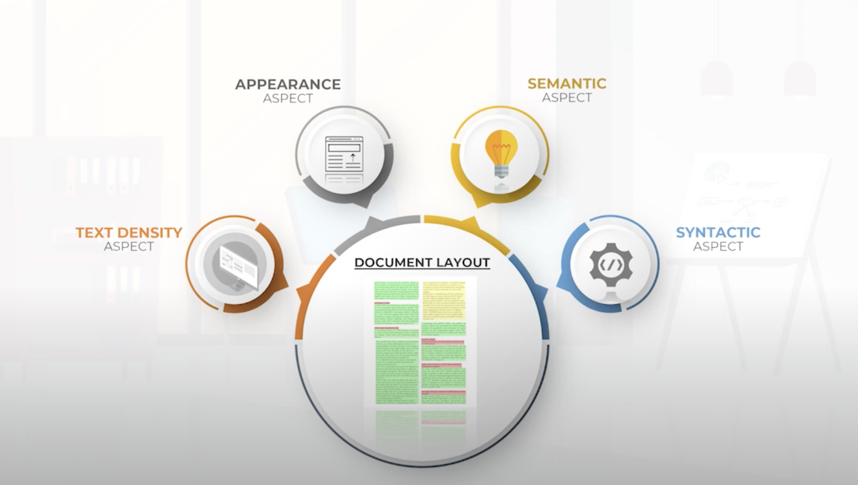
Solution Components [cntd.]

Slide 10
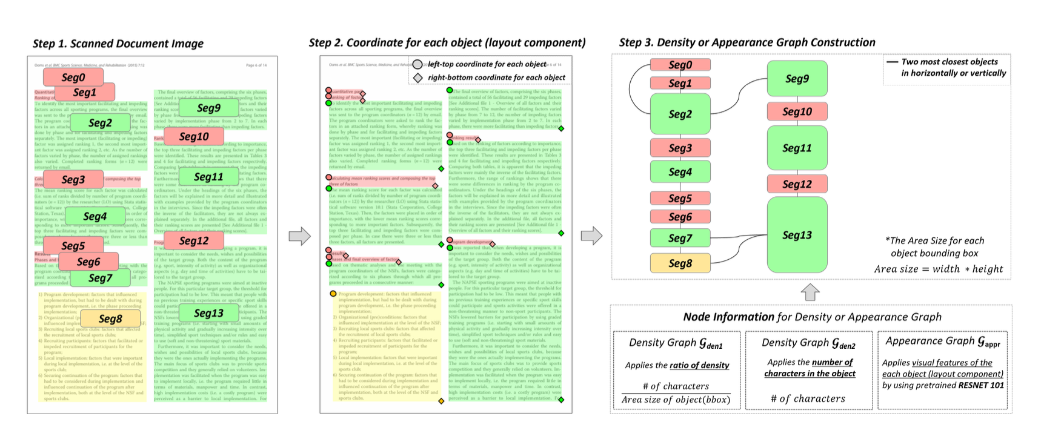
Density-aspect and Appearance-aspect Graph

Slide 11
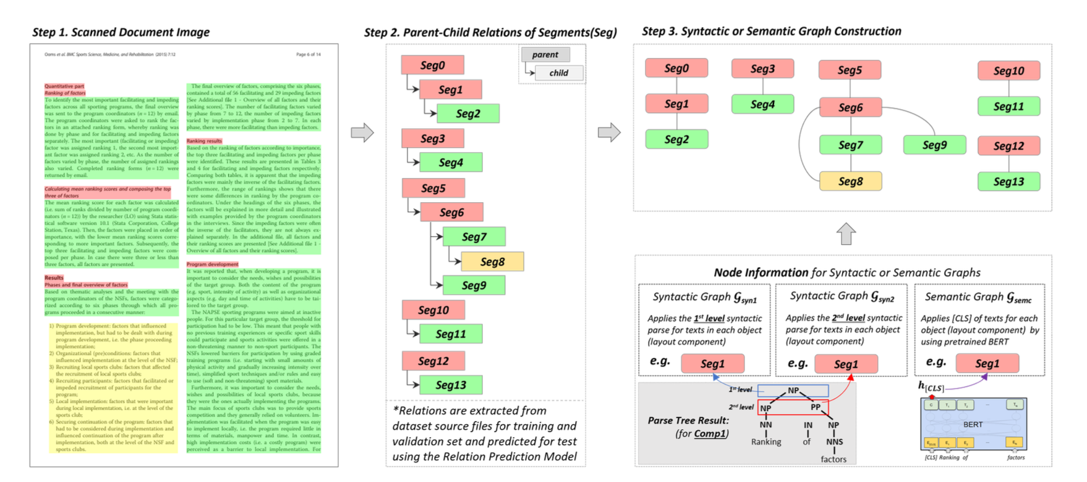
Syntactic-aspect and Semantic-aspect Graph

Slide 12
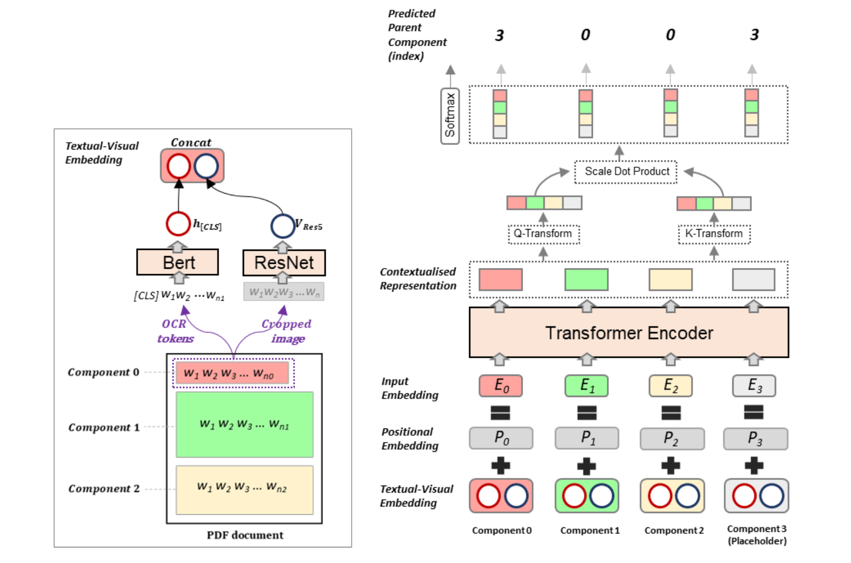
Relation Prediction Model

Slide 13
DocGCN : Architecture & Results
04

Slide 14
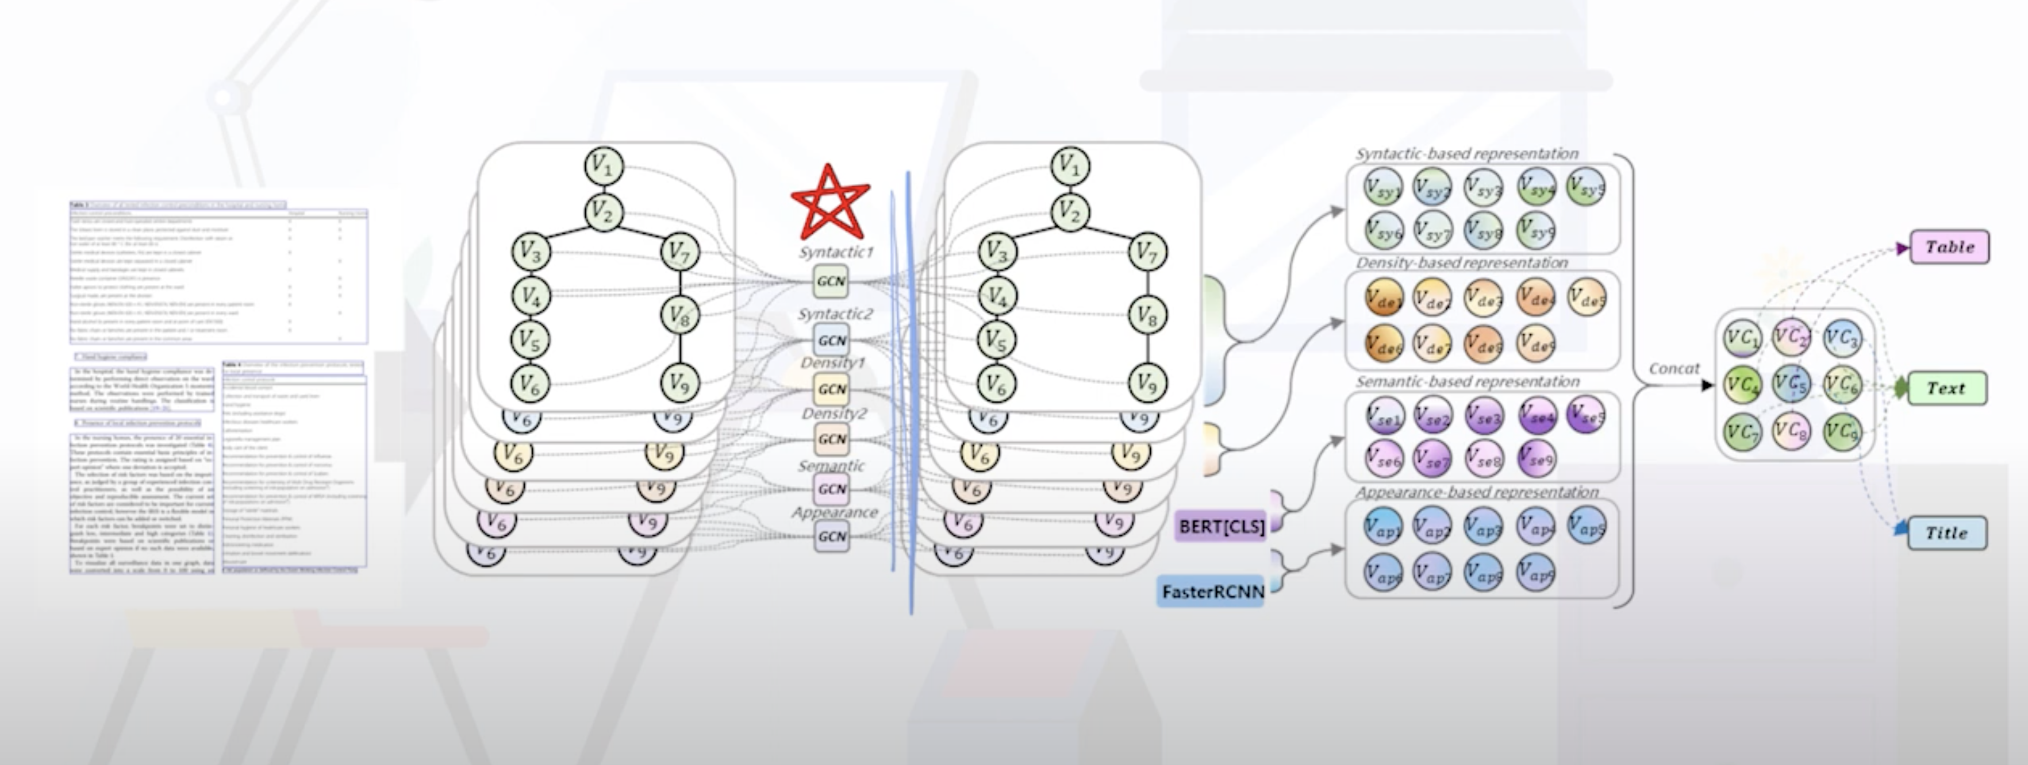
Design Architecture

Slide 15
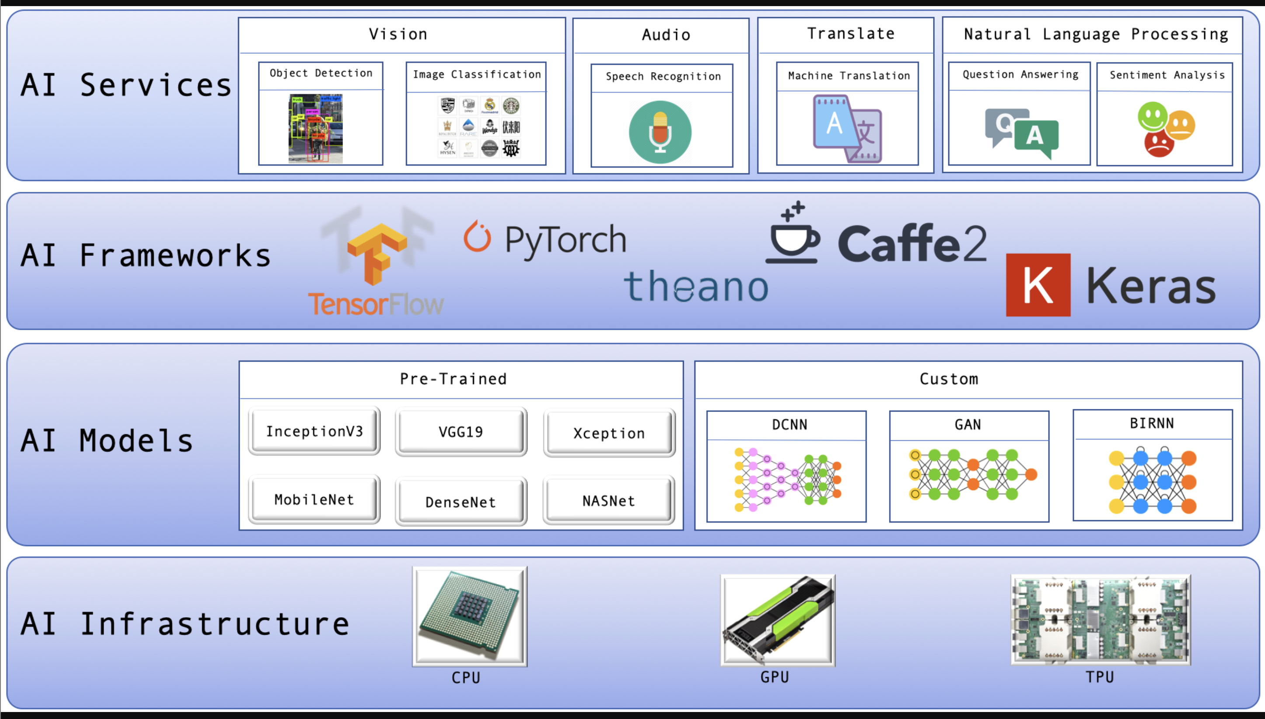
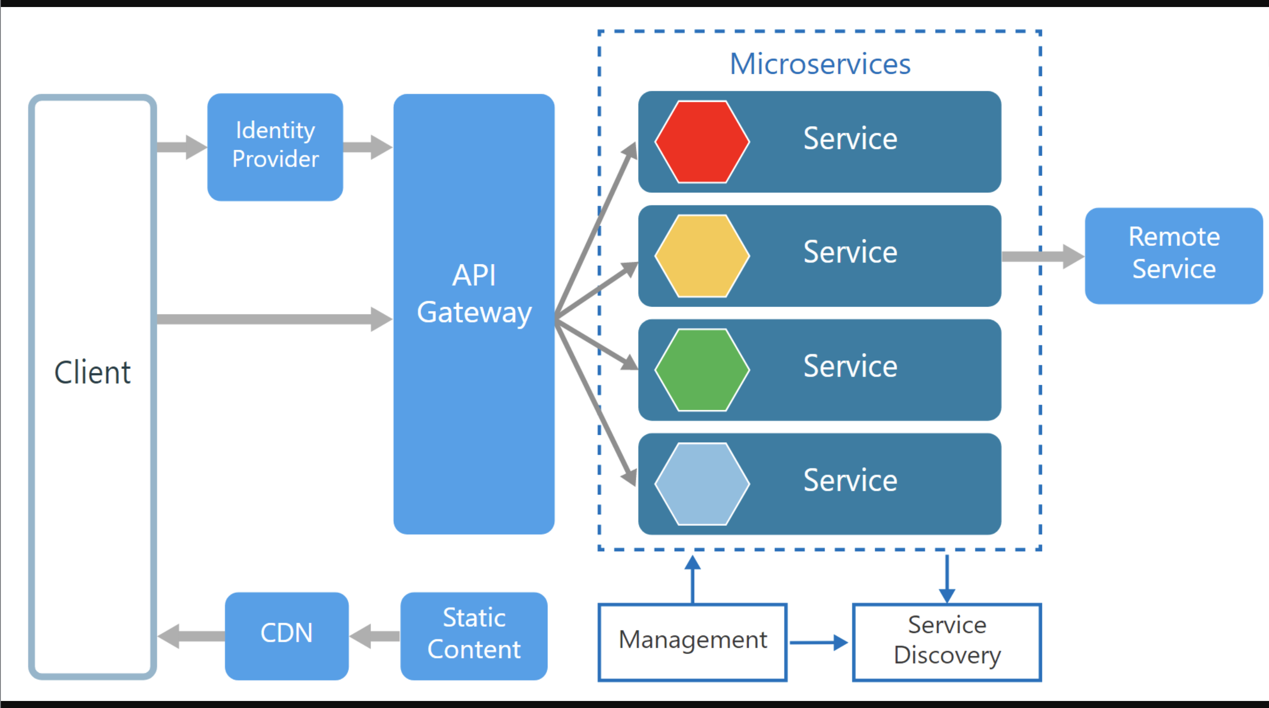
Solution Architecture

Slide 16
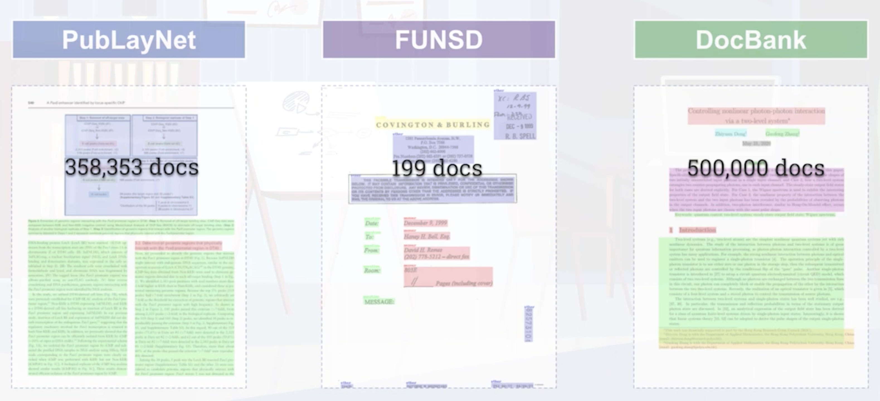
Dataset

Slide 17
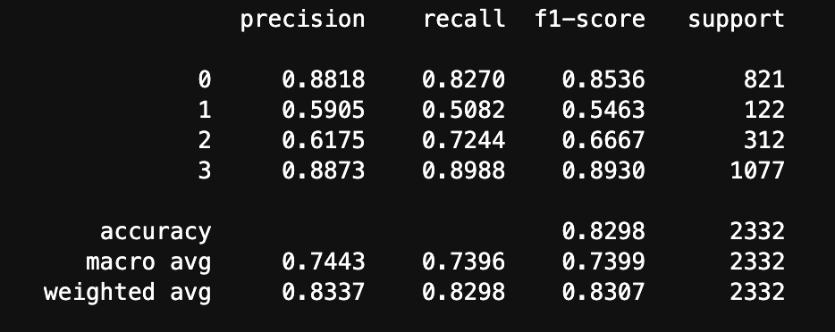
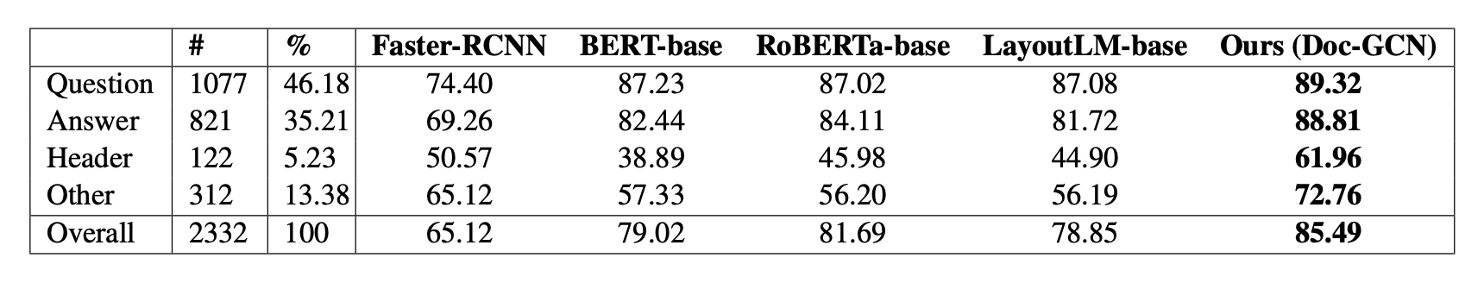
Model Performance Report – DocGCN on FUNSD dataset
F1-Score Comparison
0 - Answer
1 - Header
2 - Other
3 - Question

Slide 18
MSP Requirements
05

Slide 19
MSP Requirements
<TBD>

Slide 20
Q&A
23

